Slide 1




Sedimentation Rates from Radiocarbon Dating at Three Arctic Lakes
Charlie Kruger
School of Earth and sustainability
Northern Arizona university

Slide 2
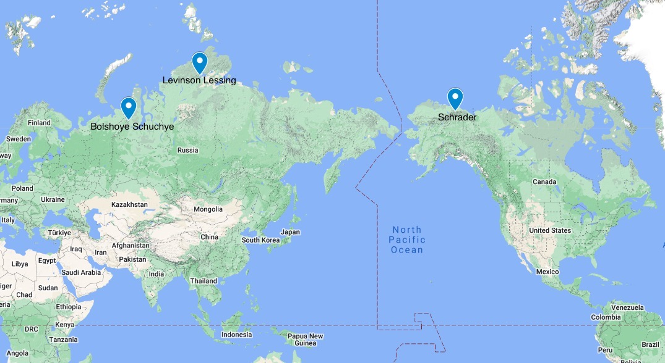
Introduction
Sedimentation in lakes can provide a more accurate look on the Earth’s climate throughout periods of rapid arctic warming with the use of radiocarbon dating​ specific intervals in arctic lake cores
Lake sediments are a useful climate archive that can provide radiocarbon dates and place changes in climate in context of time
Study contributes to the Rapid Arctic Warming project, which aims to understand the processes and patterns of rapid arctic warming during the past 15,000 years
The goal of this research is to improve the existing age control for lake sediments at three Arctic lakes
The new ages are used to estimate sediment accumulation rates extending back 15,000 years at each lake
Fig. 1 Location of three study lakes (from google maps)

Slide 3
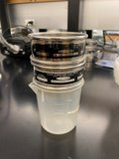
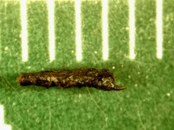
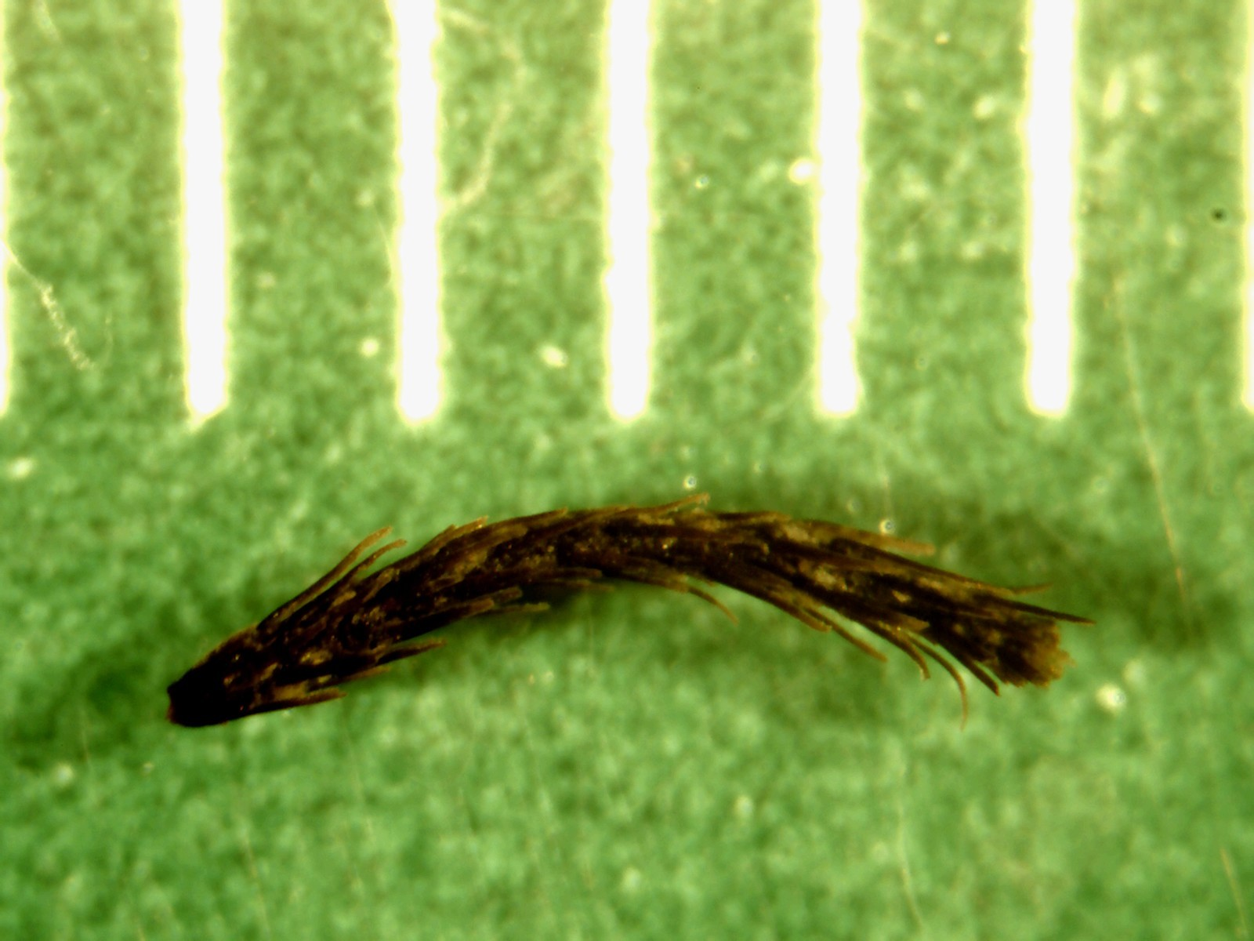
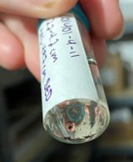
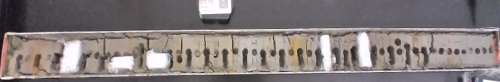
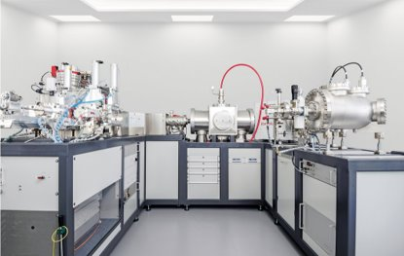
Methods and Materials
(mm)
I
(mm)
I
I
I
(c.)
(a)
Existing sediment cores from 3 Arctic lakes were sampled​
Samples were chosen to cover periods during which Arctic Climate experiences rapid change
A total of 38 samples, 1-4 cm thick, were sieved at 150 µm
Aquatic and terrestrial plant fragments were hand-picked from sieves and cleaned using sonication and acid-base-acid treatment
Radiocarbon was measured on the NAU ACE Lab MICADAS
Age versus depth models were generated for each lake using BACON software (Blaauw et al. 2011)
(b)
(d)
(e)
Fig. 2. Sample preparation. (a) Sieves. (b) Twig. (c) Drepanocladus moss. (d) sorted sample from Levinson Lessing. (e) sampled core from Schrader lake
Fig. 3. Mini Carbon Dating System used to analyze radiocarbon samples (Ionplus)

Slide 4
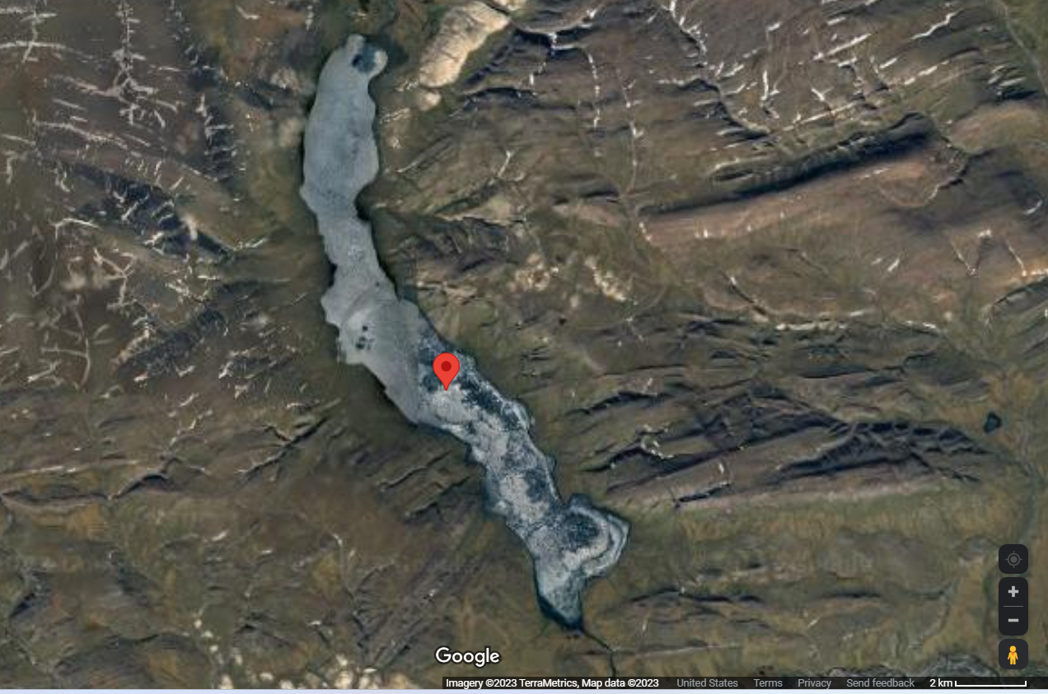
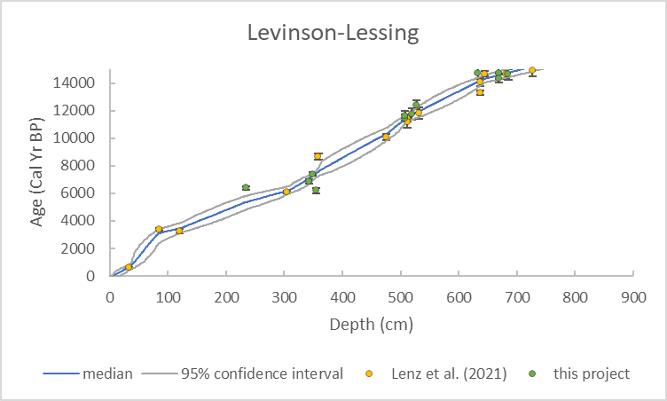
Lake Levinson-Lessing
Located in Taymyr Peninsula, Siberia​
30 total radiocarbon ages, including 13 new ages​ from this project
Average sediment accumulation rate of 20.3 years per centimeter over the past 15,000 years
4 km
Fig. 4. Lake Levinson-Lessing (Google Earth).
Fig. 5. New age model for sediment core from Lake Levison-Lessing.

Slide 5
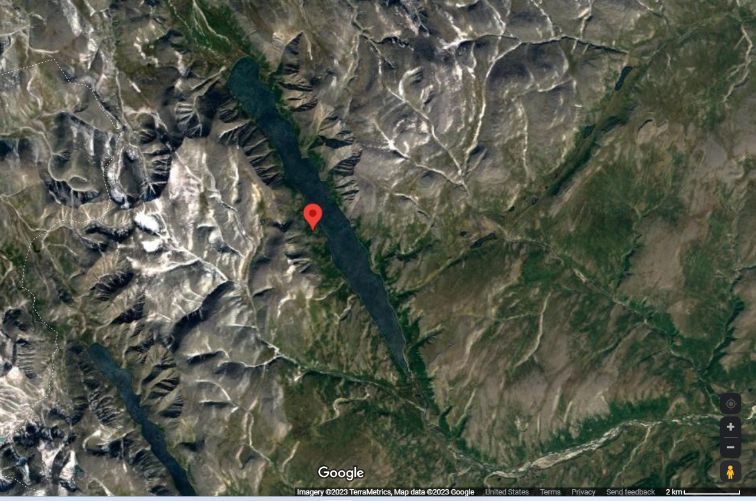
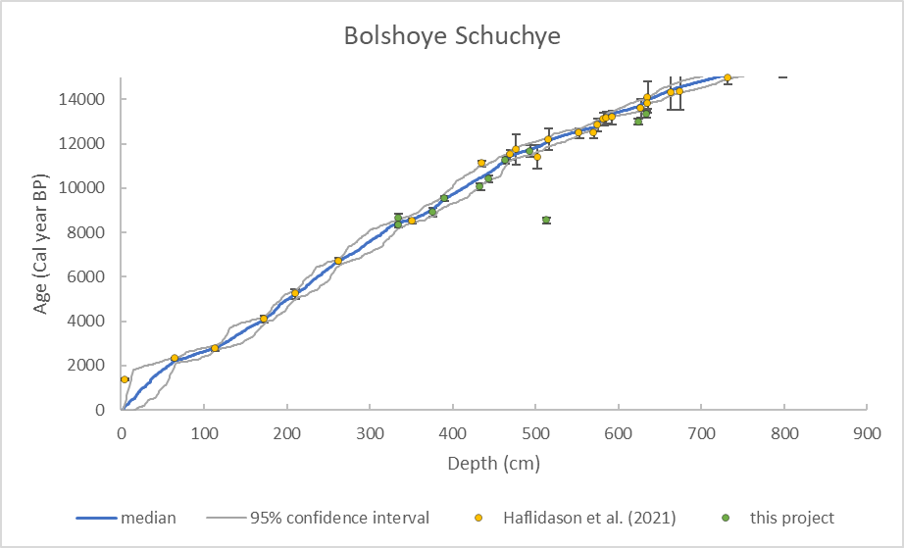
Lake Bolshoye Schuchye
Located in Polar Urals, Russia
35 total radiocarbon ages, including 11 new ages​ from this project
Average sediment accumulation rate of 14.7 years per centimeter over the past 15,000 years
4 km
Fig. 6. Bolshoye Schuchye (Google Earth).
Fig. 7. New age model for sediment core from Lake Bolshoye Schuchye.

Slide 6
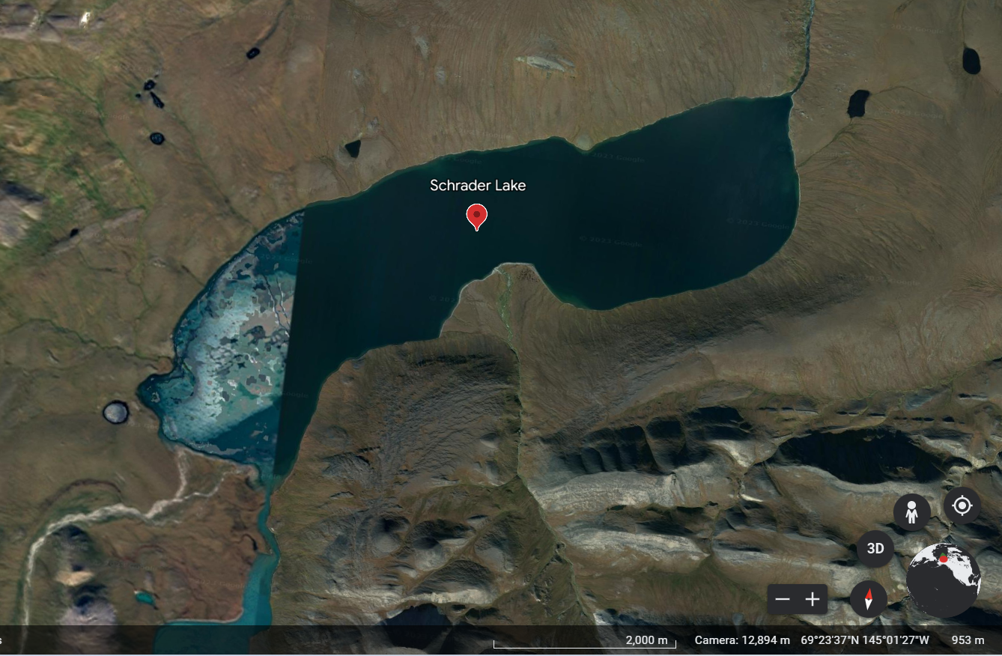
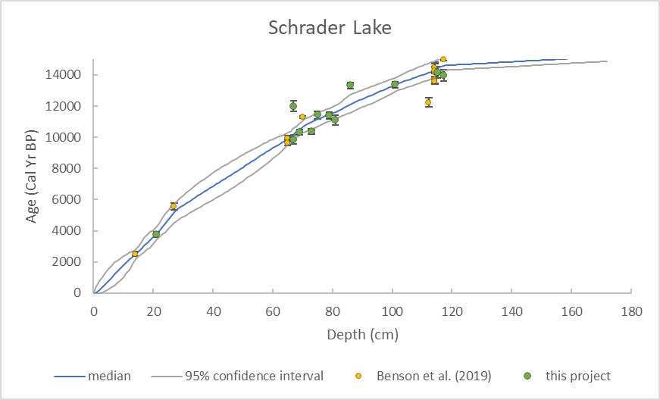
Schrader Lake
Located in Brooks Range, northeastern Alaska
24 total radiocarbon ages, including 14 new ages​ from this project
Average sediment accumulation rate of 87.1 years per centimeter over the past 15,000 years
2 km
Fig. 8 Schrader Lake (Google Earth).
Fig. 9. New age model for sediment core from Schrader Lake.

Slide 7
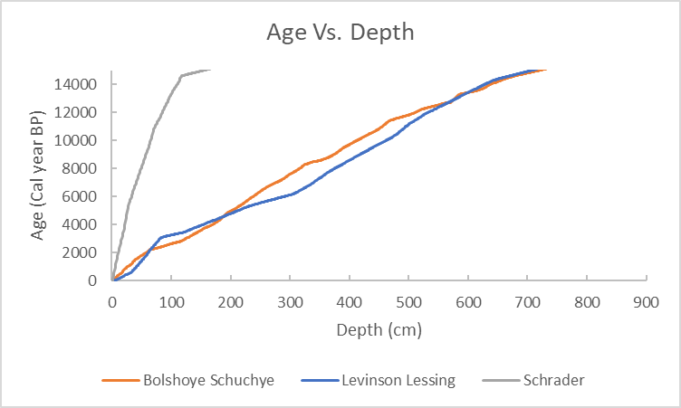
Discussion
Figure 10 compares the age vs. depth of the three lakes
Schrader had a much slower sedimentation rate than the other two lakes.
The Schrader Lake core was taken close to the shoreline, which most likely has a lower sedimentation rate
Fig. 10. Age vs depth models comparing all three lakes from this project

Slide 8
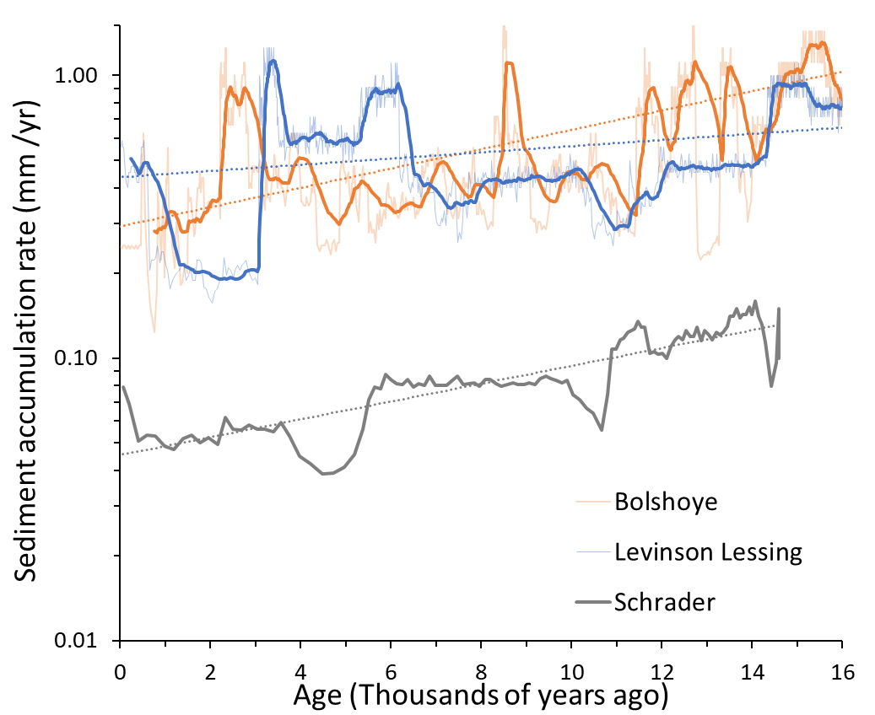
Discussion
p=5E⁻²⁵⁶, R² =0.59
Figure 11 shows the average sediment accumulation in each lake per year. The graph also contains a trendline which gives the general direction in which the data is moving
No synchronous fluctuations in sedimentation rate among lakes implies a local influence rather than widespread climate fluctuations
Overall decrease in sedimentation rate towards the present at all three lakes
Fitting a linear regression to each dataset, Levinson Lessing had the least significant relationship, with increasing significance in Schrader lake, and the most significant relationship in Lake Bolshoye Schuchye
Decrease in sedimentation rate possibly caused by a decrease in precipitation and therefore less runoff driven erosion and transport of sediment to the lake
In addition, build up of tundra vegetation following the last major ice age protected soil from erosion, decreasing sedimentation​
p=1.7E⁻¹¹, R² =0.05
p=1.5E⁻²⁴, R² =0.46
Fig. 11. Sediment accumulation rate at all three lakes studied for this project

Slide 9
Conclusion
This project has improved the age control for sediment cores from three Arctic lakes by adding 38 new radiocarbon ages
Overall multi-millennial decrease in sedimentation rate over the past 15,000 years might reflect the progressive build up of vegetation or decrease in runoff toward the present

Slide 10
References
Benson, C. et al. 2019 A 16,000-yr-long sedimentary sequence from Lakes Peters and ​Schrader (Neruokpuk Lakes), northeastern
Brooks Range, Alaska. Quaternary Research, 92, 609-625.
Blaauw, et al. 2011 Flexible paleoclimate age-depth models using an autoregressive gamma process. Bayesian Analysis, 6.
Haflidason, H. et al. 2021 High‐resolution chronology of 24 000‐year long cores from two ​lakes in the Polar Urals, Russia, correlated
with palaeomagnetic inclination records with ​a distinct event about 20 000 years ago. Journal of Quaternary Science, 37, 778-
789.​
Heaton, T. J. et al. 2021 Radiocarbon: A key tracer for studying Earth’s dynamo, climate system, ​carbon cycle, and Sun.
Science, 374.
Lacourse, T., Gajewski, K., 2020 Current practices in building and reporting age-depth ​models. Quaternary Research, 96, 28-38.​
Lenz, M. et al. 2021 Climate and environmental history at Lake Levinson‐Lessing, Taymyr ​Peninsula, during the last 62 kyr. Journal
of Quaternary Science, 37, 836-850.​
Rapid Arctic Warming Project. UB WordPress - UBIT - University at Buffalo, ubwp.buffalo.edu/rapidarcticwarming/rapid-arctic-
warming-project/.

Slide 11
Acknowledgements
Mentors: Darrell Kaufman and Leah Marshall
Laboratory supervision: Jordon Bright
Radiocarbon analyses: NAU ACE Isotope Lab
Funding: NASA Space Grant and National Science Foundation

